Slide 1
Management of Virtual Execution Environments
3 June 2008
Resources and Services Virtualization
without Barriers
http://www.reservoir-fp7.eu
Author:
Ignacio M. llorente (llorente@dacya.ucm.es)
The research leading to these results has received funding from the European Community's Seventh Framework Programme (FP7/2007-2013]]) under grant agreement n° 215605.

Slide 2
Index
The Project Perspective
The Architectural Perspective
The Technological Perspective
The Research Perspective
Management of Virtual Execution Environments
Notes:
This slide shows the contents of the presentation, we will describe the activity on management of VEEs from different perspectives:

Slide 3
The Project Perspective

Slide 4

The Activity within the Project
On-demand Resource Provisioning => Activity 4
Support on-demand execution of VEEs ensuring SLA commitment (off-line)
Service
Admin.
Service
End-user
User Layer
Service
Consumer
Service
Manager
A4. Service Management
Service
Service
Provider
Optimal Exploitation of Physical Resources
Meet dynamic consumer demands (service layer) and variety of configurations with a limited number of physical resources, supporting the migration of VEEs to partner infrastructure sites
A3. VEE
Management
Virtual Execution Environment Management System
Infrastructure
Provider
A2. VEE Infr.
Enablement
Grid Site
Leverage the New VEE Infrastructure Enablement Technology => Activity 2
Access to the new grid-optimized virtualization technology (mainly, new performance and relocation features)
Value Chain
Architecture
Management of Virtual Execution Environments
Notes:
This slide shows the three-layer architecture of RESERVOIR. From bottom up we have activity 2 on, acti…
So, this is the location of Activity 3
- From Activity 4 perspective, the aim of activity 3 is “on-..:”, that is to support the …
- From the perspective of the owner of the physical resources, the aim of activity is “optimal exploitation …”, that is to meet …
- From the perspective of Activity 2, the aim of activity 3 is to “leverage…”, that is to access..

Slide 5
A Infrastructure Site
Cloud Node
(Infrastructure Site)
Resource (Host)
VEE
A business multi-tier service is submitted
Each service comprises multiple VEEs that may be initially allocated to balance workload
A computing cluster service is submitted
The service is elastic (VEEs can be added removed)
Services and individual VEEs can be controlled and monitored
VEEs are re-allocated according to policies for capacity provision to meet SLAs
Management of Virtual Execution Environments
Notes:
Let us illustrate the functionality that will be provided by the VEE Management layer with the infrastructure site in the slide.
Let us assume that a …
It is important to remark that …

Slide 6
Dynamic Provisioning of Computational Clusters
SGE Frontend
User Requests
  SGE interface
Virtualized SGE nodes
VEE Manager
VMM
VMM
VMM
Dedicated SGE nodes
Cluster Nodes

Slide 7
Dynamic Provisioning of Computational Clusters
Cluster Consolidation
  Multiple worker nodes in a single resource
  VMM functionality (e.g. live migration)
SGE Frontend
Virtualized SGE nodes
VEE Manager
VMM
VMM
VMM
Dedicated SGE nodes
Cluster Nodes

Slide 8
Dynamic Provisioning of Computational Clusters
Cluster Partitioning
  Performance partitioning (dedicated workernodes)
  Isolate service workload
  Dedicated HA partitions
SGE Frontend
Virtualized SGE nodes
VEE Manager
VMM
VMM
VMM
Dedicated SGE nodes
Cluster Nodes

Slide 9
Dynamic Provisioning of Computational Clusters
Heterogenous Workloads
  Custom worker-node configurations (queues)
  Dynamic provision of cluster configurations
  Example: on-demand VO workernodes in Grids
SGE Frontend
Virtualized SGE nodes
VEE Manager
VMM
VMM
VMM
Dedicated SGE nodes
Cluster Nodes

Slide 10
The Architectural Perspective

Slide 11
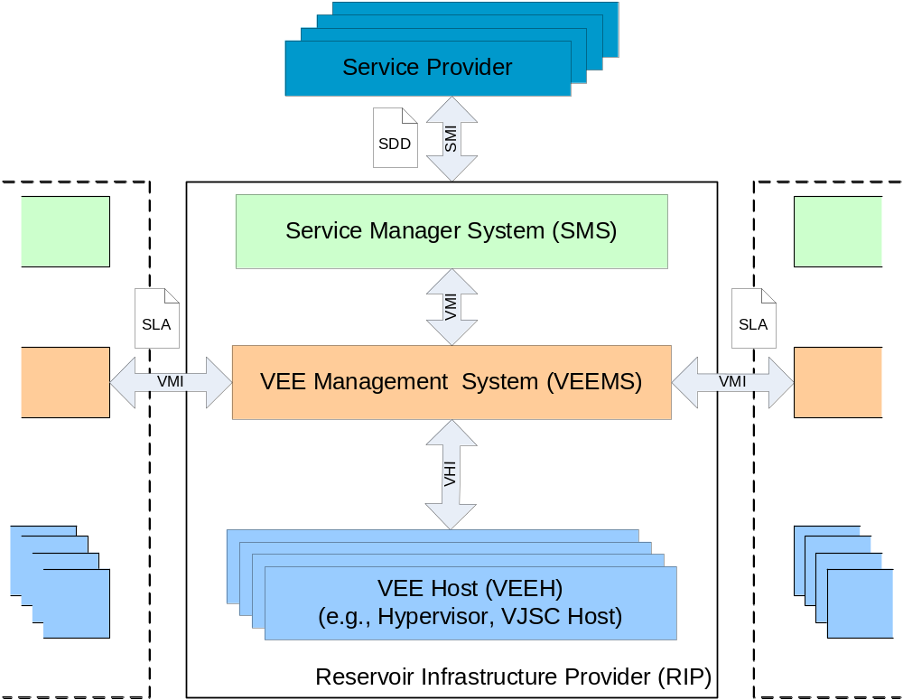
Relationships with other Components
Notes:
The service manager will submit, control and monitor services using the VEE Manager Interface
The same public interface will be used for the federation of cloud or infrastructure sites
The VEE manager will manage the VEE life-cycle within each host or physical resource by using the VEE Host interface
VMI: provides abstraction from a multi-host and multi-site environment
VHI: provides abstraction from the underlying virtualization technology

Slide 12
Public Interfaces
VEE Manager Interface (planned for open standard)
  Deploy, control and monitor services (sets of VEEs)
    Service Submission Interface
    Service Elasticity Interface (VEEAdd, VEERemove…)
    Service Control Interface (VEEUpdate…)
    Service Monitor Interface (VEEMonitor…)
    …
  Monitor and Control VEEM Sites
    VEEM Site Monitoring Interface
    VEEM Site Migration Interface
    …
Management of Virtual Execution Environments
Notes:
VMI comprises two subsets, the first one is used to …; while the second one is used to…

Slide 13
Internal Architecture
Allocation Policy Management
Control the execution of VEEs according to infrastructure capacity provisioning policies to ensure SLA compliance in different use cases
Activity 4: Service Management
VMI
VEE Core
VEE Policy
Engine
VMI
VMI
VHI plug-in
VHI
VEE Provisioning and Supervision
Manage the discovery and preparation of physical resources, and dynamic deployment, allocation, monitoring and termination of VEEs
Accessing to remote virtualization technology
Translate management orders from VEE core to protocols supported by specific virtualization platforms, including remote sites
Virtualizer
Virtualizer
Activity 2: VEE Infrastructure Enablement
Presentation Title
Notes:
The VEE Manager consists of three main components:… responsible for… its aim is …

Slide 14
The Technological Perspective

Slide 15
VEEM as Main Technology Outcome
Open-source implementation of
    VEE Core
    API (VMI)
    Virtual plug-ins
    Inter-VEEMs protocols
    VEE Policy Engine
Management of Virtual Execution Environments

Slide 16
Aim of the New Technology
Dynamic Management of VEEs
    Transform a physical infrastructure into a virtual infrastructure by dynamically managing execution of VEEs
    Extend the benefits of the virtualization technologies from a single resource to a resource pool, decoupling the server not only from physical infrastructure but also from physical location
Application
Application
Guest OS
Guest OS
Decoupling the server from the physical location
VEE Management
Virtualizer
Virtualizer
Notes:
It is responsible for … so transforming…

Slide 17
Capabilities of the new Technology
Capabilities
  Server consolidation to a lower number of systems
    Reduce space, administration effort, power and cooling requirements or support the shutdown of systems without interfering workload.
  Partitioning of physical infrastructure
    Dynamically allocate resources to different service clusters
  Support of heterogeneous workloads
    Merge existing infrastructures to eliminate vertical computing silos
Management of Virtual Execution Environments
Notes:
Leveraging virtualization platforms
New capabilities are obtained by leveraging functionality provided by underlying virtualization technology
The new … to..

Slide 18
Capabilities of the New Technology
Capabilities
  Dynamic scaling of the physical infrastructure
    Support changes in capacity demands
  Dynamic scaling-out of the infrastructure (federation)
    Meet fluctuation demands for resources
  Infrastructure allocation based on SLA parameters
    Support SLAs negotiated in framework agreements
  Support for elastic services
    Meet dynamic capacity requirements from services
  High availability
    Protect systems from failures

Slide 19
Differentiating Factors
Outstanding features
  Generic and independent of the underlying virtualization technology
  Open source and based on standards
  Automatic provision of VEEs to meet pre-defined infrastructure site policies for SLA commitment
  Support of set of VEEs (forming a single service) with affinity and deployment ordering rules
  Access to remote grid sites, supporting on-demand access and federation of data-centers
Management of Virtual Execution Environments

Slide 20
Base Software
The OpenNEbula Virtual Infrastructure Engine is being used as base software for VEE core
  OpenNEbula.org
Other external components under evaluation
  Globus Toolkit
  gLite gP-BOX
  Brein ERA,…
Enhacements driven by the requirements
  Real-life RESERVOIR use cases
  OGF Grid&Virtualization use cases
Management of Virtual Execution Environments
Notes:
As base software we will use existing components from other projects

Slide 21
The Research Perspective

Slide 22
Research Challenges
Dynamic management of VEEs
Heuristics for capacity provision to meet SLA commitments
Architectures for federation of VEEMs
Heuristics for capacity provision across infrastructure sites
…
Management of Virtual Execution Environments
Notes:
This activity opens new highly relevant research lines…

Slide 23










Partners Involved in the Activity
Management of Virtual Execution Environments

Slide 24

Thanks!!

